Slide 1
DigSig/Digital Identity Doc Overhaul
2021-2022

Slide 2
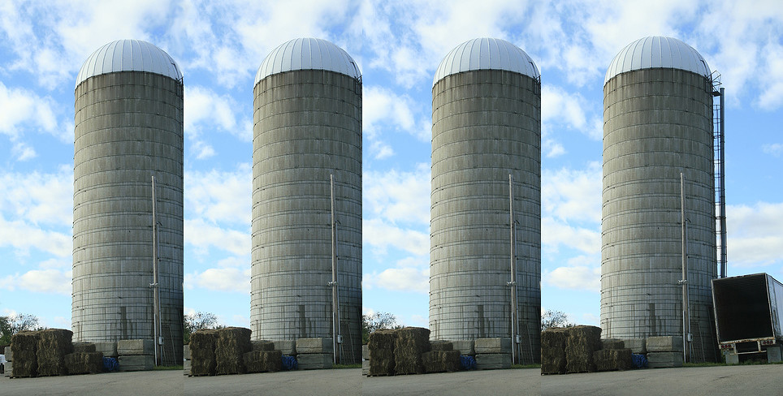
The current situation
No communication across teams
Adobe Sign is evolving into a signature platform for Adobe products.
Field needs more and better content. Lorie Groth is spearheading a doc revamp for PMM.
Much duplicated, deprecated, and contradictory content.
No common plan for assets, go urls, coordination
Multiple locations: two places on helpx, marketing pages, exp league, devnet-docs
Ben Acrobat enterprise deploy
Prabhat Acrobat end user
Scott Adobe Sign
Lorie G. Marketing digital identity
Lori D. Adobe Sign videos
This Photo by Unknown Author is licensed under CC BY
This Photo by Unknown Author is licensed under CC BY

Slide 3
What to do?
Remove duplicated content: e.g. dig ID definition
Remove deprecated content
Decider: everyone
Driver
Lorie Groth
Update content, including rebrand, new Adobe programs, etc
Reorganize: Create top level product agnostic dig sig home; link
Re-link to the right places + common go url library

Slide 4
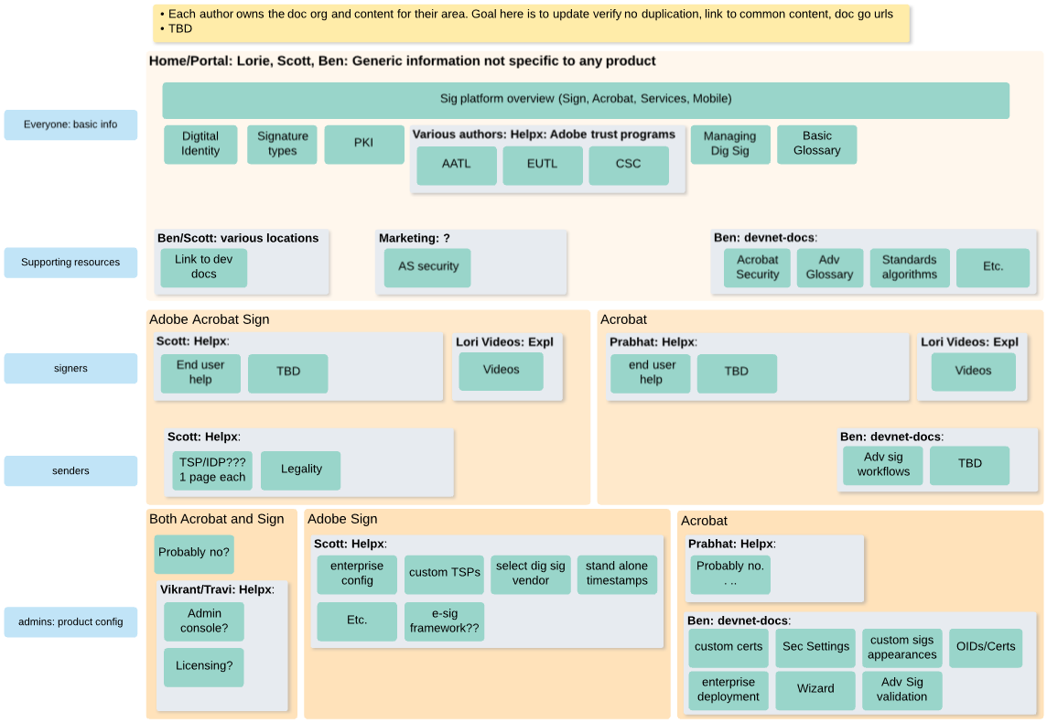
Doc org (evolving)
Diagram source

Slide 6
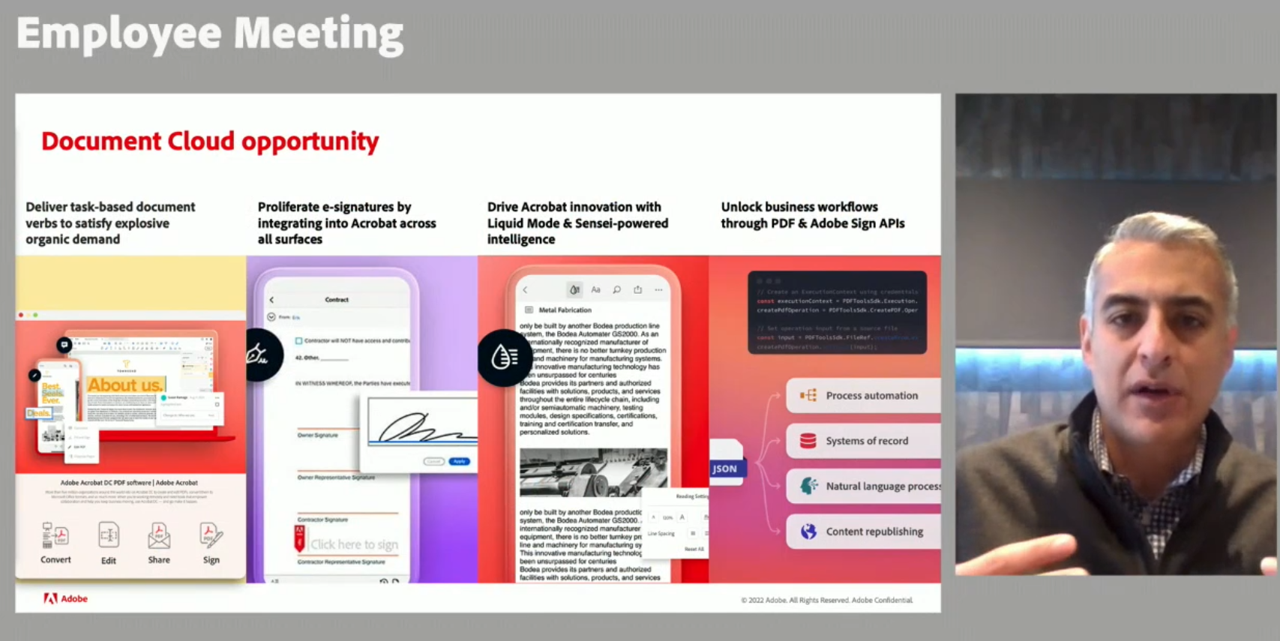

Slide 7
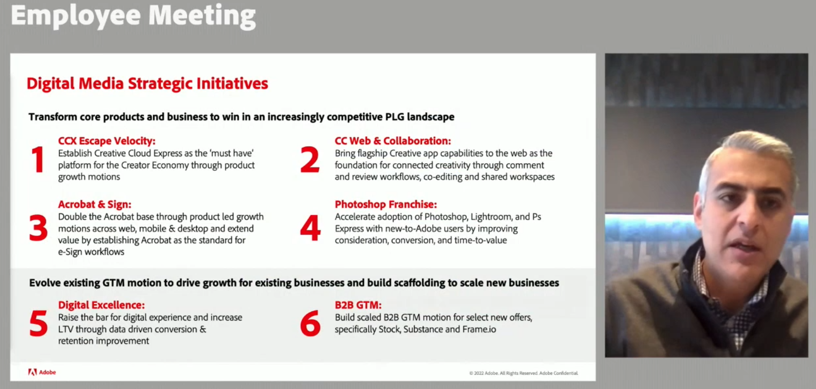

Slide 9

Is it worth leveraging Helpx (but not AEM)?
Authoring environment
Public locations
Github is not required.
Github.corp.adobe
Github/adobe
Helpx
Any advantages?
Integration with other content
Search
Localization
Discoverability
Metrics
Other
Ben’s notes:
End users don’t care
Doesn’t seem possible
Custom process if AEM unused
Doubt it matters, but don’t know
Have metrics, but all?
?
AEM
Not used

Slide 10
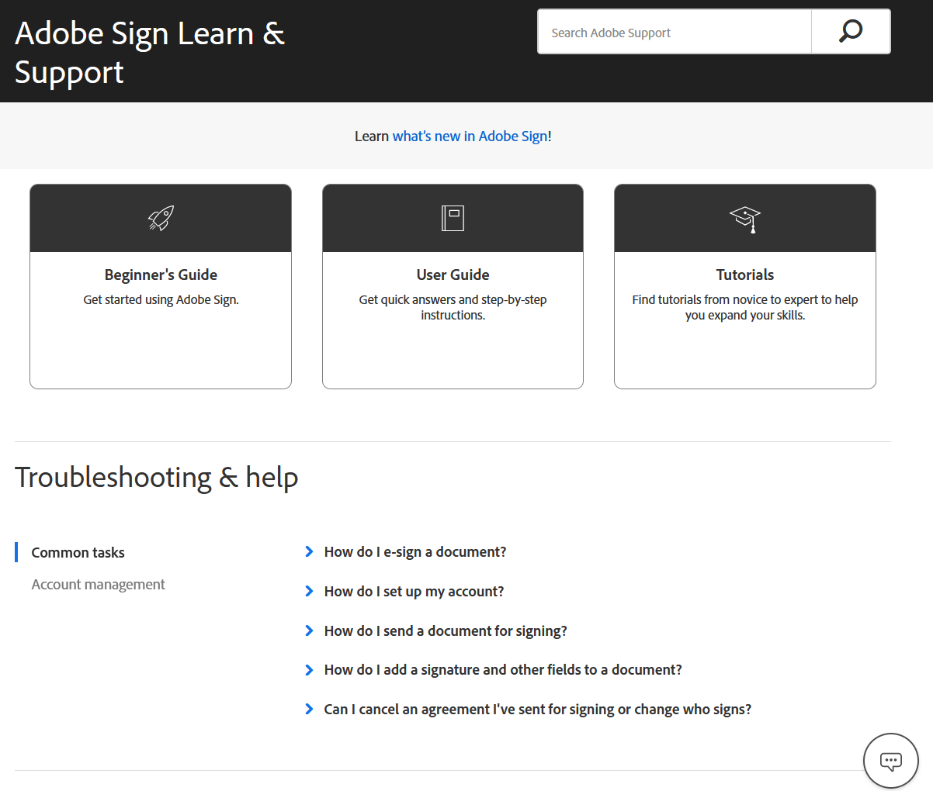
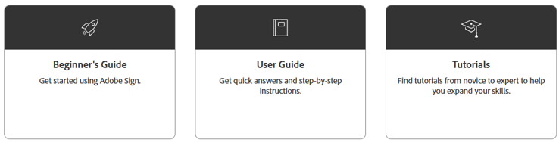
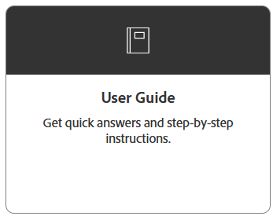

Developer tasks
Learn about APIs, tools, and demos that support building custom apps
Developer tasks
Where can I find details about APIs and creating applications?
Where can I learn about integrating Acrobat Sign in our enterprise apps (such as Salesforce?)

